Slide 1
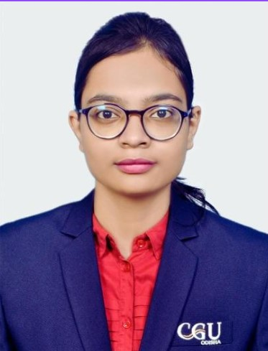
Student Details
Name : AKANKSHA KUMARI
SkillsBuild Email ID : rmahto1969@gmail.com
College Details : C. V. Raman Global University, Bhubaneswar
Internship Domain : Data Analytics
Internship Start and End Date : 12/06/2023 to 24/07/2023

Slide 2


problem Statement: Analysis of superstore database
This project analyzes a dataset of sales data from a fictional superstore. The goal of the project is to identify trends and patterns in the data that can help the superstore improve its business performance.

Slide 3
AGENDA
Perform exploratory data analysis (EDA) to gain insights into the data.
Identify key drivers of sales.
Develop recommendations for the superstore to improve its business performance.
Increasing sales of high-margin products Targeting its marketing efforts to specific customer segments.
Identify trends and patterns in the data that can help the superstore improve its business performance.

Slide 4
PROJECT OVERVIEW!
Steps to be performed for analysis:
1.Define the problems
2.Importing Libraries
3.Importing the dataset
4.Cleaning of data-Pre-Processing of data
5.summarizing data set to extract insights
6.Visualization Of Data
7.Conclusion

Slide 5
WHO ARE THE END USERS of this project?
Software developers
Region Customer segments
Salesperson
Retailers
Producers

Slide 6
My SOLUTION AND ITS VALUE PROPOSITION !
The project found that the following factors are key drivers of sales:
Product category Region Customer segment Sales channel
Increasing sales of high-margin products Targeting its marketing efforts to specific customer segments.
The project also found that the superstore could improve its business performance by:
Increasing sales of high-margin products Targeting its marketing efforts to specific customer segments
Expanding into new regions
Project Contributions
I contributed to this project by:
Cleaning and preprocessing the data Performing EDA Identifying key drivers of sales Developing recommendations for the superstore Project.

Slide 7

How did you customize the project and make it your own
Project Challenges
The biggest challenge of this project was cleaning and preprocessing the data
The dataset was not well-formatted and contained a lot of missing values.
Customized Approach
Identify trends and patterns in the data that can help the superstore improve its business performance.
Develop recommendations for the superstore to improve its business performance.
Perform exploratory data analysis (EDA) to gain insights into the data.

Slide 8
MODELLING TOOLS
The project was implemented using the following tools and technologies:
Python, Pandas, NumPy, Matplotlib
Importing Libraries
Pre-Processing of data & Exploratory data analysis
Dropping of Postal Code Column
Heatmap of covariance among the set of variables

Slide 9
RESULT
This project was a valuable learning experience for me. I learned how to collect, clean, and analyze data. I also learned how to identify key drivers of business performance and develop recommendations for improvement. I am confident that the skills I learned in this project will be valuable in my future career.
Outcomes of Project:
https://github.com/Akanks-cell/Analysis-of-superstore-database

Slide 10

Links
https://docs.python.org/3/library/tkinter.html
https://github.com/Akanks-cell/Analysis-of-superstore-database
https://chat.openai.com/

Slide 11


